Slide 1
Ice Model Calibration using Semi-continuous Spatial Data
Won Chang
Division of Statistics and Data Science
Department of Mathematical Sciences
University of Cincinnati

Slide 2
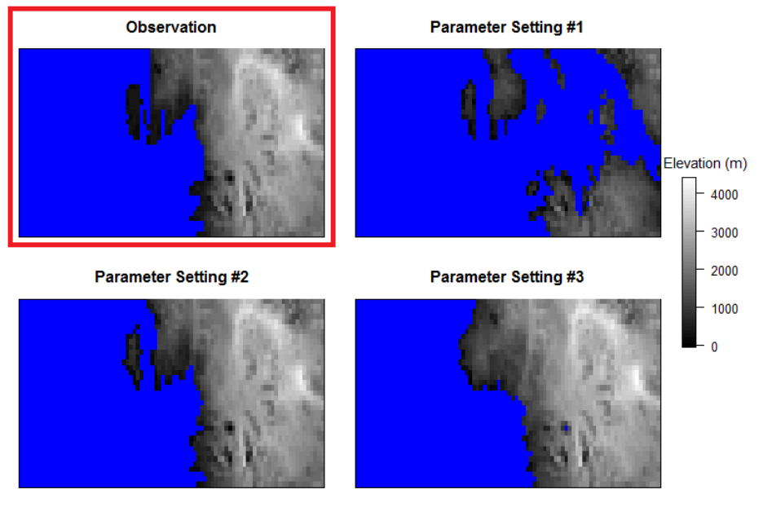

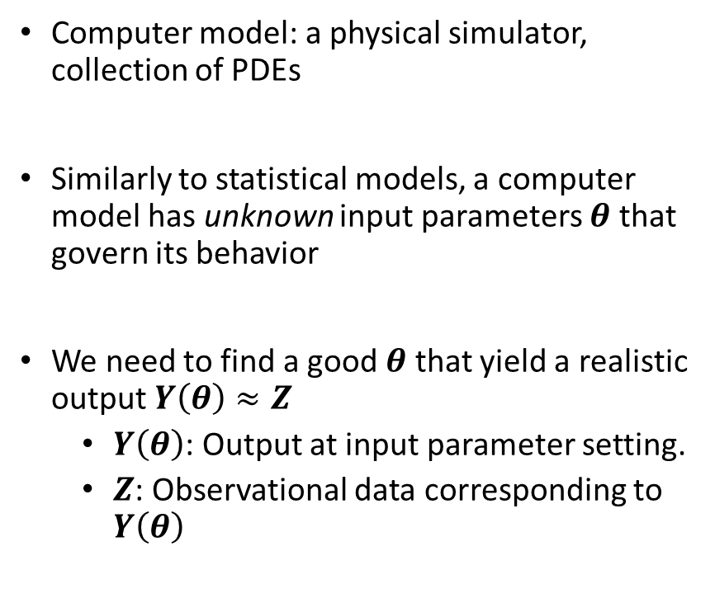



Computer Model?
Example: Simulating Antarctic Ice Sheet
Computer model: a physical simulator, collection of PDEs
Similarly to statistical models, a computer model has unknown input parameters $θ$ that govern its behavior
We need to find a good $θ$ that yield a realistic output $Y\left(θ\right)≈Z$
$Y\left(θ\right)$: Output at input parameter setting.
$Z$: Observational data corresponding to $Y\left(θ\right)$
$$(Z)$$
$$Y\left(θ_{1}\right)$$
$$Y\left(θ_{2}\right)$$
$$Y\left(θ_{3}\right)$$

Slide 3
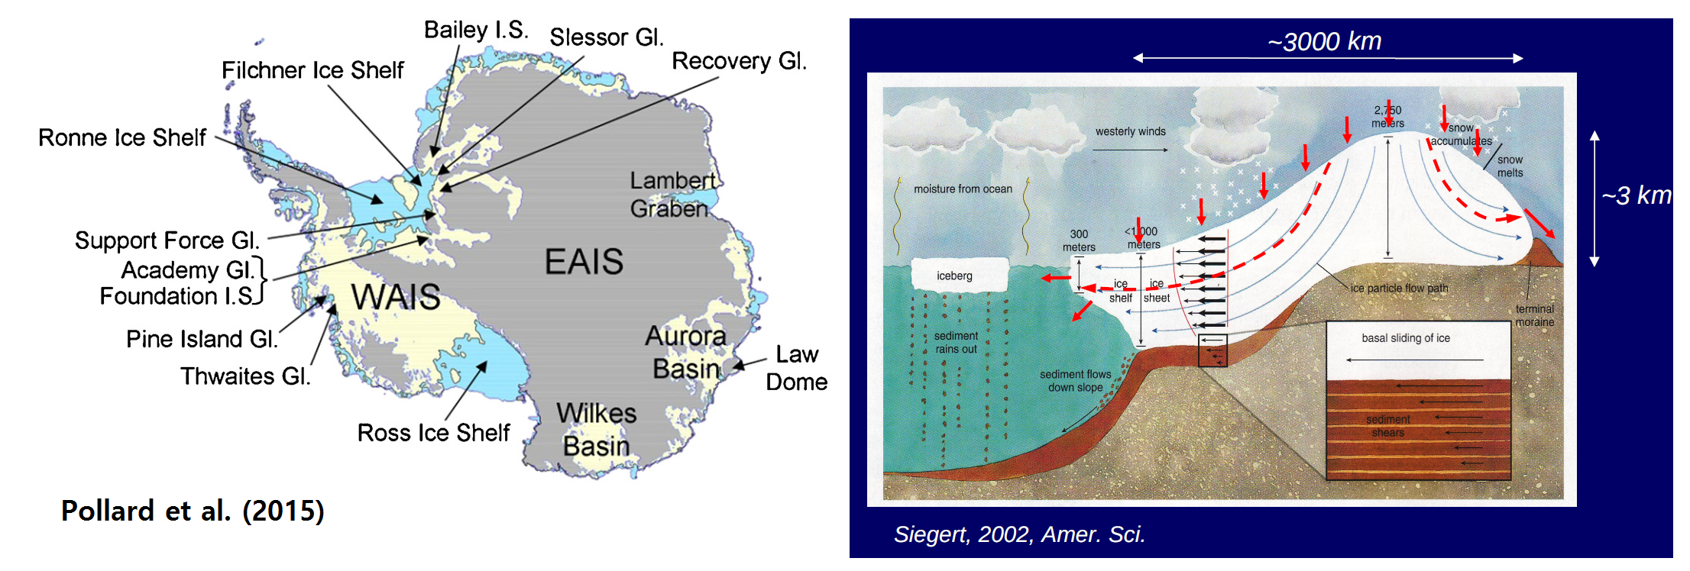
Calibrating Antarctic Ice Sheet Model
We want to estimate unknown parameters in a physical simulator for the West Antarctic Ice Sheet (WAIS).

Slide 4
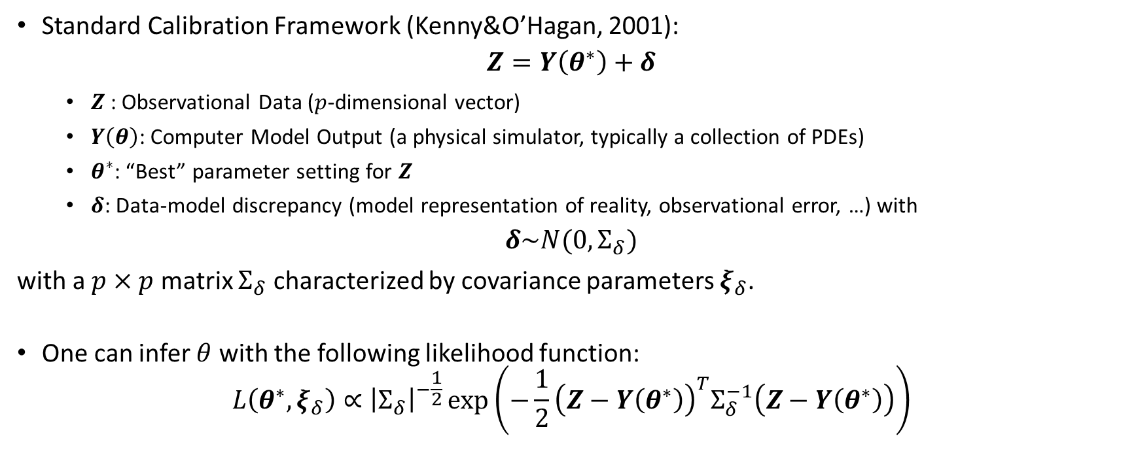
Standard Calibration Framework
Standard Calibration Framework (Kenny&O’Hagan, 2001):
$$Z=Y\left(θ^{∗}\right)+δ$$
$Z$: Observational Data ($p$-dimensional vector)
$Y\left(θ\right)$: Computer Model Output (a physical simulator, typically a collection of PDEs)
$θ^{∗}$: “Best” parameter setting for $Z$
$δ$: Data-model discrepancy (model representation of reality, observational error, …) with
$$δ\sim N(0,Σ_{δ})$$
with a $p×p$ matrix $Σ_{δ}$ characterized by covariance parameters $ξ_{δ}$.
One can infer $θ$ with the following likelihood function:
$$L\left(θ^{∗},ξ_{δ}\right)∝{\left|Σ_{δ}\right|}^{−\frac{1}{2}}\exp\left(−\frac{1}{2}{\left(Z−Y\left(θ^{∗}\right)\right)}^{T}Σ_{δ}^{−1}\left(Z−Y\left(θ^{∗}\right)\right)\right)$$

Slide 5
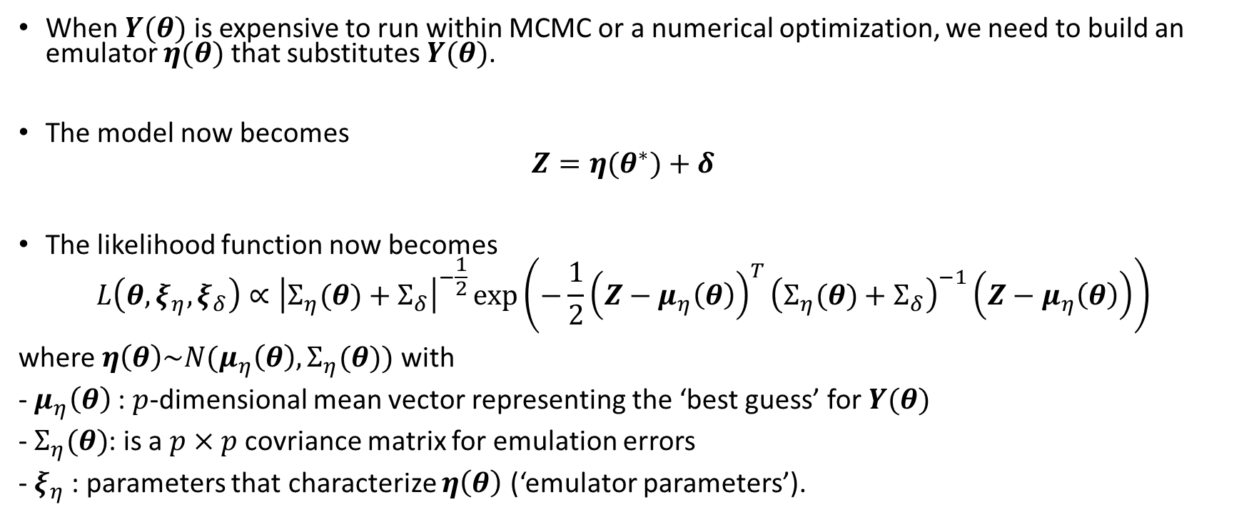
Emulator for Expensive Computer Model
When $Y(θ)$ is expensive to run within MCMC or a numerical optimization, we need to build an emulator $η(θ)$ that substitutes $Y(θ)$.
The model now becomes
$$Z=η(θ^{∗})+δ$$
The likelihood function now becomes
$$L\left(θ,ξ_{η},ξ_{δ}\right)∝{\left|Σ_{η}(θ)+Σ_{δ}\right|}^{−\frac{1}{2}}\exp\left(−\frac{1}{2}{\left(Z−μ_{η}\left(θ\right)\right)}^{T}{\left(Σ_{η}(θ)+Σ_{δ}\right)}^{−1}\left(Z−μ_{η}\left(θ\right)\right)\right)$$
where $η\left(θ\right)\sim N(μ_{η}\left(θ\right),Σ_{η}(θ))$ with
- $μ_{η}\left(θ\right)$: $p$-dimensional mean vector representing the ‘best guess’ for $Y(θ)$
- $Σ_{η}(θ)$: is a $p×p$ covriance matrix for emulation errors
- $ξ_{η}$: parameters that characterize $η\left(θ\right)$ (‘emulator parameters’).

Slide 6
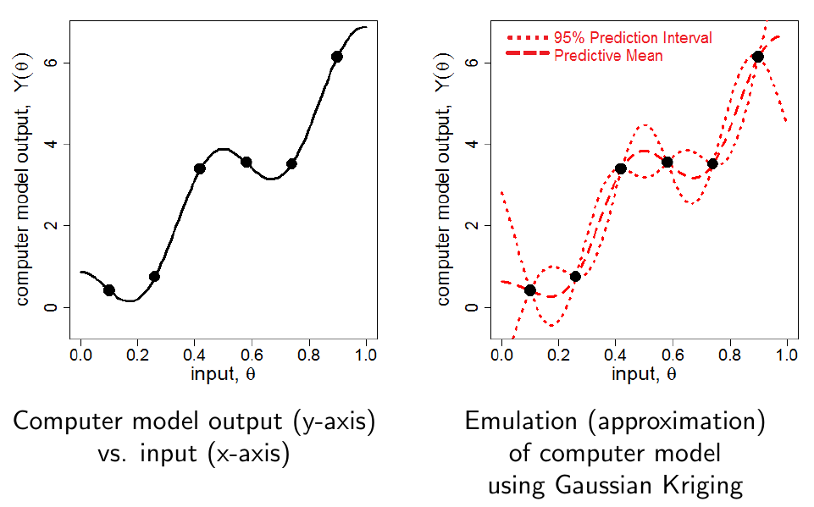
Illustration for Emulation Step (1-D)

Slide 7
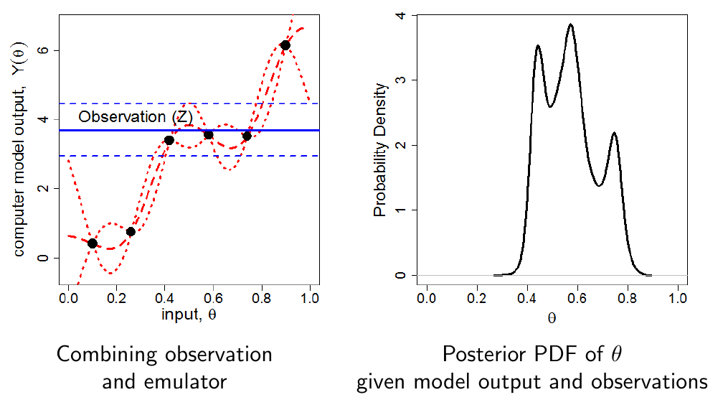
Illustration for Calibration Step (1-D)
$$L\left(θ,ξ_{η},ξ_{δ}\right)∝{\left|Σ_{η}(θ)+Σ_{δ}\right|}^{−\frac{1}{2}}\exp\left(−\frac{1}{2}{\left(Z+η\left(θ\right)\right)}^{T}{\left(Σ_{η}(θ)+Σ_{δ}\right)}^{−1}\left(Z−η\left(θ\right)\right)\right)$$

Slide 8
Calibration using Semi-Continuous Spatial Data
Challenges: the model output and observational data are semi-continuous spatial data

Slide 9
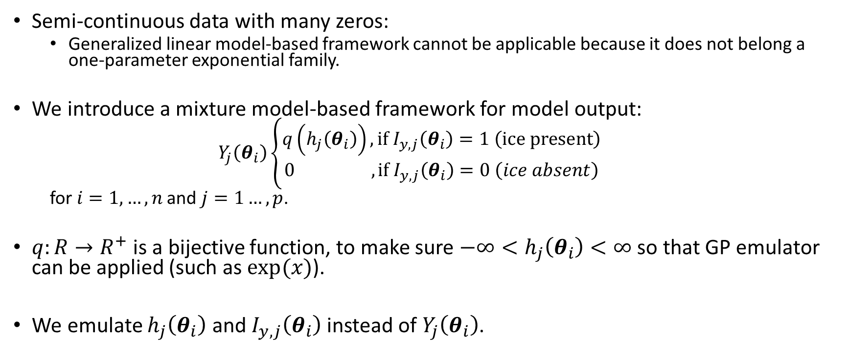
Mixture Model-based Approach
Semi-continuous data with many zeros:
Generalized linear model-based framework cannot be applicable because it does not belong a one-parameter exponential family.
We introduce a mixture model-based framework for model output:
$$Y_{j}\left(θ_{i}\right)\left\{\begin{aligned}q\left(h_{j}\left(θ_{i}\right)\right), if I_{y,j}\left(θ_{i}\right)=1 \left(ice present\right) \\ 0 , if I_{y,j}\left(θ_{i}\right)=0 \left(ice absent\right)\end{aligned}\right.$$
for $i=1,…, n$ and $j=1…,p$.
$q:R→R^{+}$ is a bijective function, to make sure $−∞<h_{j}\left(θ_{i}\right)<∞$ so that GP emulator can be applied (such as $exp⁡(x)$).
We emulate $h_{j}\left(θ_{i}\right)$ and $I_{y,j}\left(θ_{i}\right)$ instead of $Y_{j}\left(θ_{i}\right)$.

Slide 10
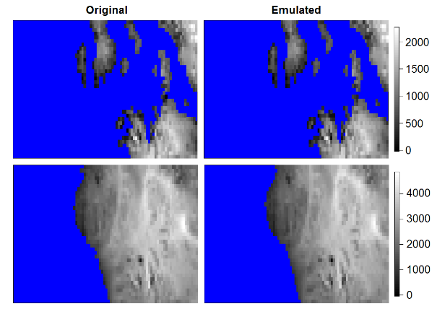
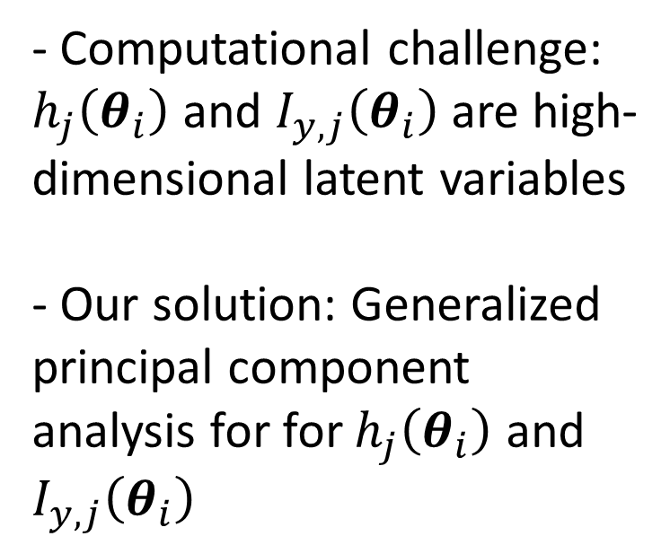
Leave 10-percent-out Cross Validation
- Computational challenge: $h_{j}\left(θ_{i}\right)$ and $I_{y,j}\left(θ_{i}\right)$ are high-dimensional latent variables
- Our solution: Generalized principal component analysis for for $h_{j}\left(θ_{i}\right)$ and $I_{y,j}\left(θ_{i}\right)$
m

Slide 11
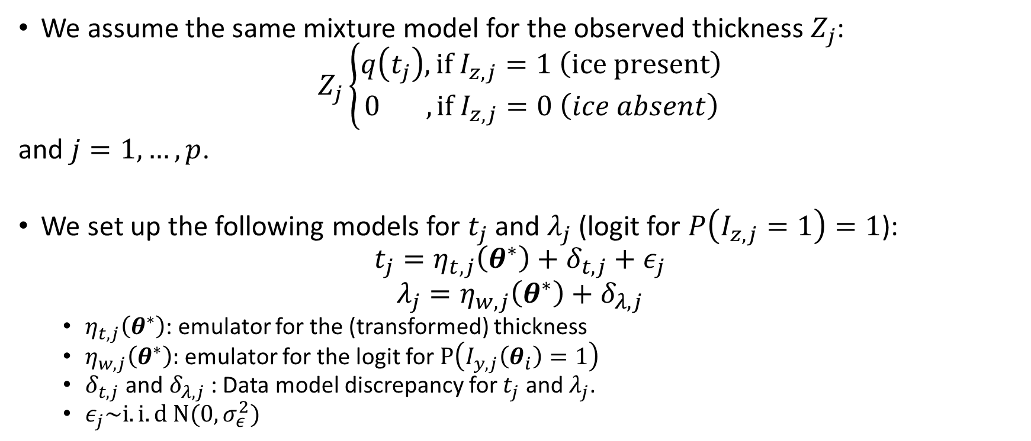
Calibration Using Semi-Continuous Spatial Data
We assume the same mixture model for the observed thickness $Z_{j}$:
$$Z_{j}\left\{\begin{aligned}q\left(t_{j}\right), if I_{z,j}=1 \left(ice present\right) \\ 0 , if I_{z,j}=0 \left(ice absent\right)\end{aligned}\right.$$
and $j=1,…,p$.
We set up the following models for $t_{j}$ and $λ_{j}$ (logit for $P\left(I_{z,j}=1\right)=1$):
$$t_{j}=η_{t,j}\left(θ^{∗}\right)+δ_{t,j}+ε_{j}$$
$$λ_{j}=η_{w,j}\left(θ^{∗}\right)+δ_{λ,j}$$
$η_{t,j}\left(θ^{∗}\right)$: emulator for the (transformed) thickness
$η_{w,j}\left(θ^{∗}\right):$ emulator for the logit for $P\left(I_{y,j}\left(θ_{i}\right)=1\right)$
$δ_{t,j}$ and $δ_{λ,j}$ : Data model discrepancy for $t_{j}$ and $λ_{j}$.
$ε_{j}\sim i.i.d N(0,σ_{ε}^{2})$

Slide 12
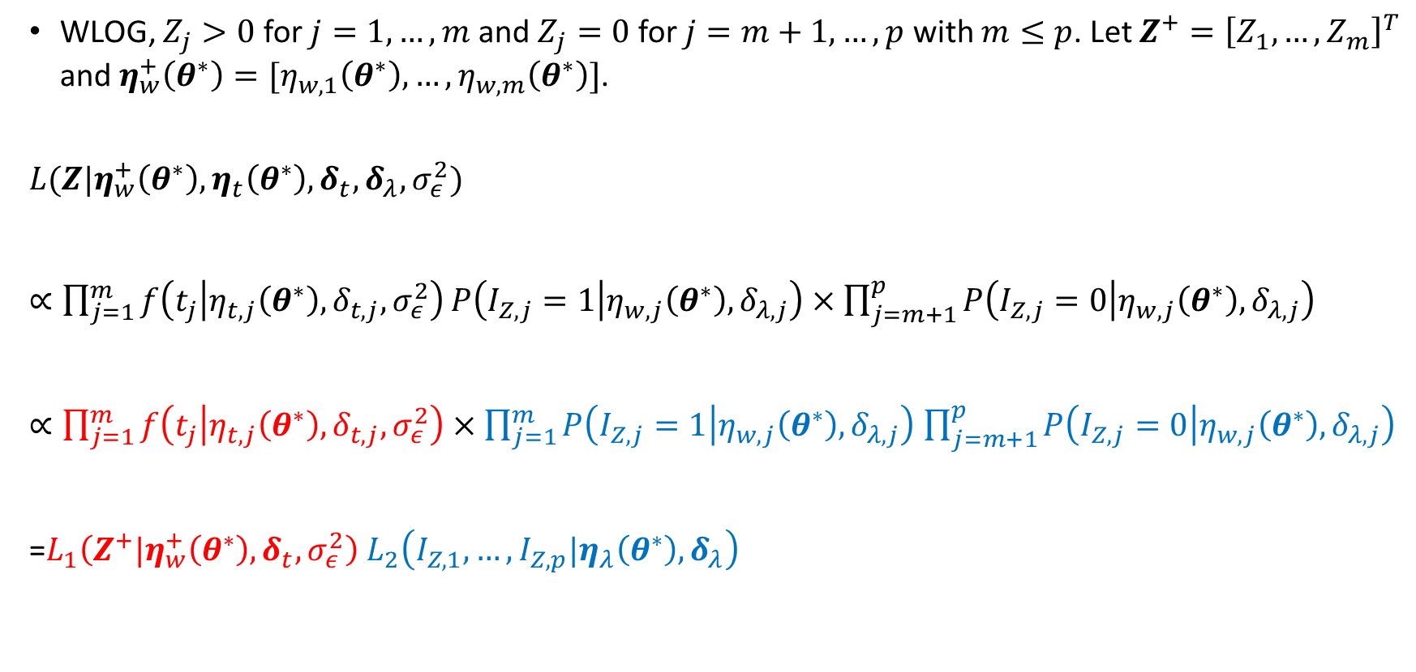
Rewriting the Likelihood Function for the Mixture Model
WLOG, $Z_{j}>0$ for $j=1,…,m$ and $Z_{j}=0$ for $j=m+1,…,p$ with $m≤p$. Let $Z^{+}={\left[Z_{1},…,Z_{m}\right]}^{T}$ and $η_{w}^{+}\left(θ^{∗}\right)=[η_{w,1}\left(θ^{∗}\right),…,η_{w,m}\left(θ^{∗}\right)]$.
$$L(Z|η_{w}^{+}\left(θ^{∗}\right),η_{t}\left(θ^{∗}\right),δ_{t},δ_{λ},σ_{ε}^{2})$$
$∝\prod_{j=1}^{m}{f\left(t_{j} | η_{t,j}\left(θ^{∗}\right),δ_{t,j},σ_{ε}^{2}\right)}P\left(I_{Z,j}=1 | η_{w,j}\left(θ^{∗}\right),δ_{λ,j}\right)$ $×\prod_{j=m+1}^{p}{P\left(I_{Z,j}=0 | η_{w,j}\left(θ^{∗}\right),δ_{λ,j}\right)}$
$∝\prod_{j=1}^{m}{f\left(t_{j} | η_{t,j}\left(θ^{∗}\right),δ_{t,j},σ_{ε}^{2}\right)}$ $×\prod_{j=1}^{m}{P\left(I_{Z,j}=1 | η_{w,j}\left(θ^{∗}\right),δ_{λ,j}\right)}$ $\prod_{j=m+1}^{p}{P\left(I_{Z,j}=0 | η_{w,j}\left(θ^{∗}\right),δ_{λ,j}\right)}$
=$L_{1}\left(Z^{+}|η_{w}^{+}\left(θ^{∗}\right),δ_{t},σ_{ε}^{2}\right)$ $L_{2}\left(I_{Z,1},…,I_{Z,p}|η_{λ}\left(θ^{∗}\right),δ_{λ}\right)$
Likelihood for Positive Thickness
Likelihood for Zero Thickness
Likelihood for Thickness
Likelihood for Binary Patterns

Slide 13
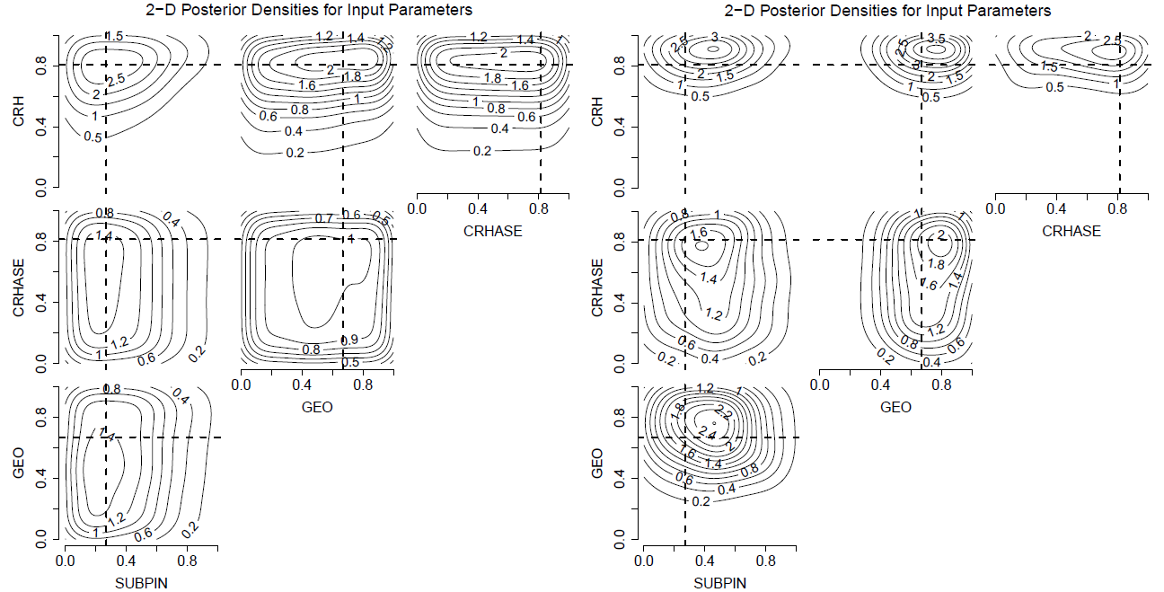

Added Information from Thickness Patterns
Results for a synthetic observation:
Binary Pattern Only (Chang et al., 2016)
Full Thickness Pattern (Chang et al., 2020)
$$L_{2}\left(I_{Z,1},…,I_{Z,p}|η_{λ}\left(θ^{∗}\right),δ_{λ}\right)$$
$L_{1}\left(Z^{+}|η_{w}^{+}\left(θ^{∗}\right),δ_{t},σ_{ε}^{2}\right)$ $L_{2}\left(I_{Z,1},…,I_{Z,p}|η_{λ}\left(θ^{∗}\right),δ_{λ}\right)$

Slide 14
Summary
Computer model calibration: a formal statistical procedure to estimate unknown parameters in a computer model
Semi-continuous spatial data from ice sheet models and observations pose statistical challenges
Our solution: mixture model-like formulation to simultaneously handle 0 values and positive continuous values

